Slide 1
Big Data Group Assignment
Predicting Property Value with respect to other predictors or independent variables

Slide 2
Business Problem
To predict property value with respect to different independent variables from 2013 American Community Dataset
Response variable is VALP: Value of the Property

Slide 3
Hypothesis
Null Hypothesis:
Value of Property is not influenced by any of the independent variable
Alternate Hypothesis:
Value of Property influenced by one or more independent variable

Slide 4
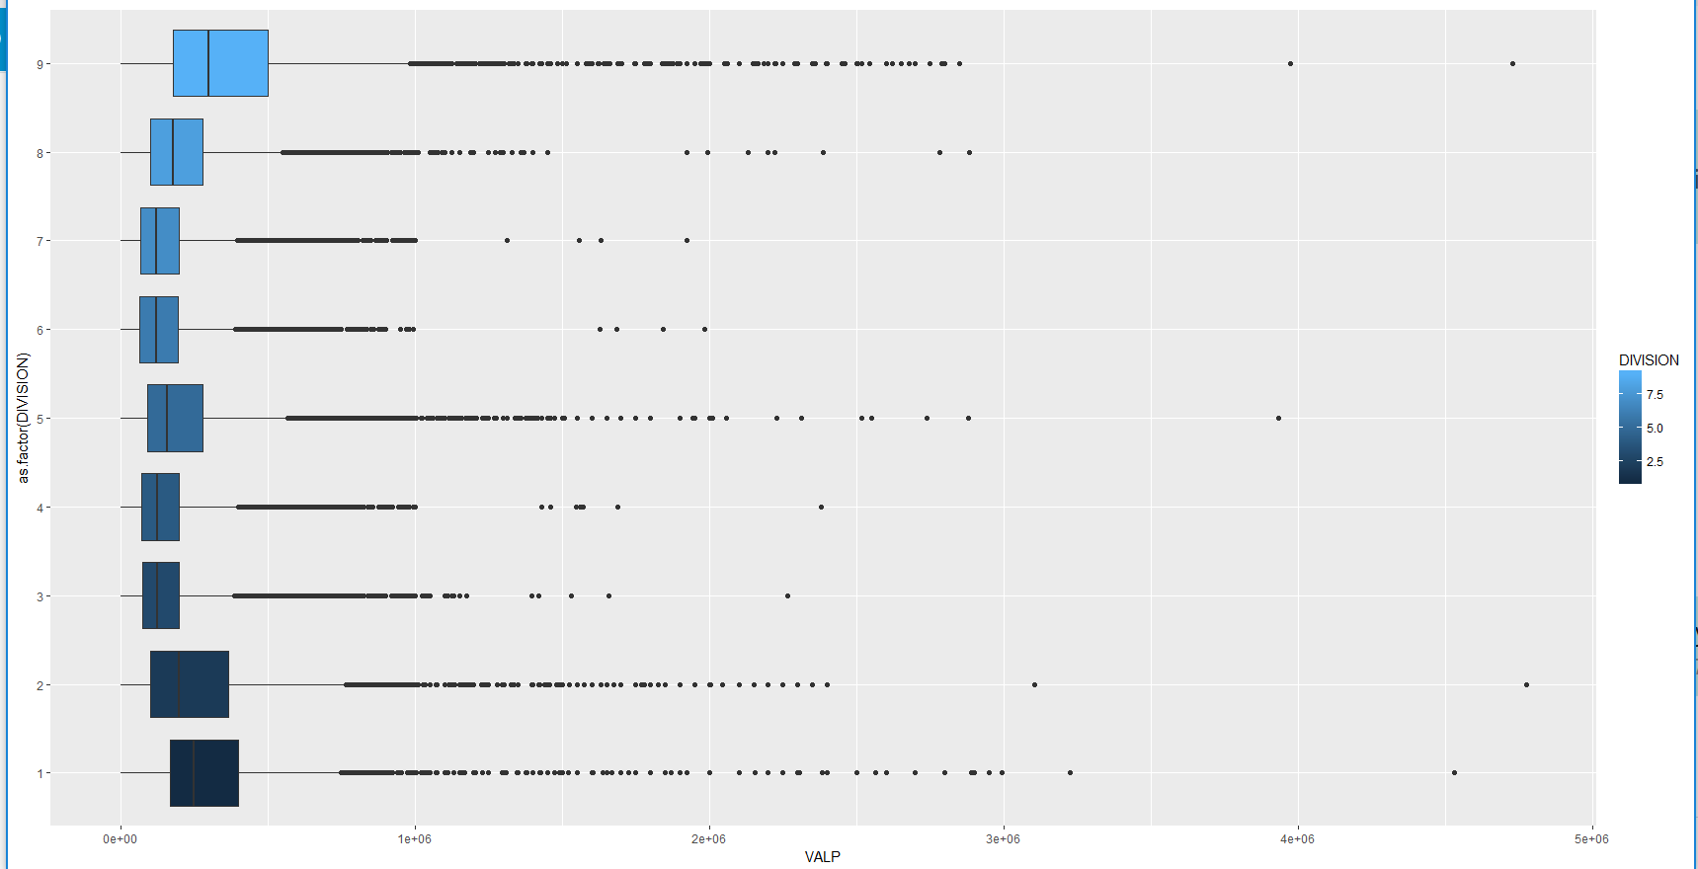
VALP vs Division…property value differing across divisions

Slide 5
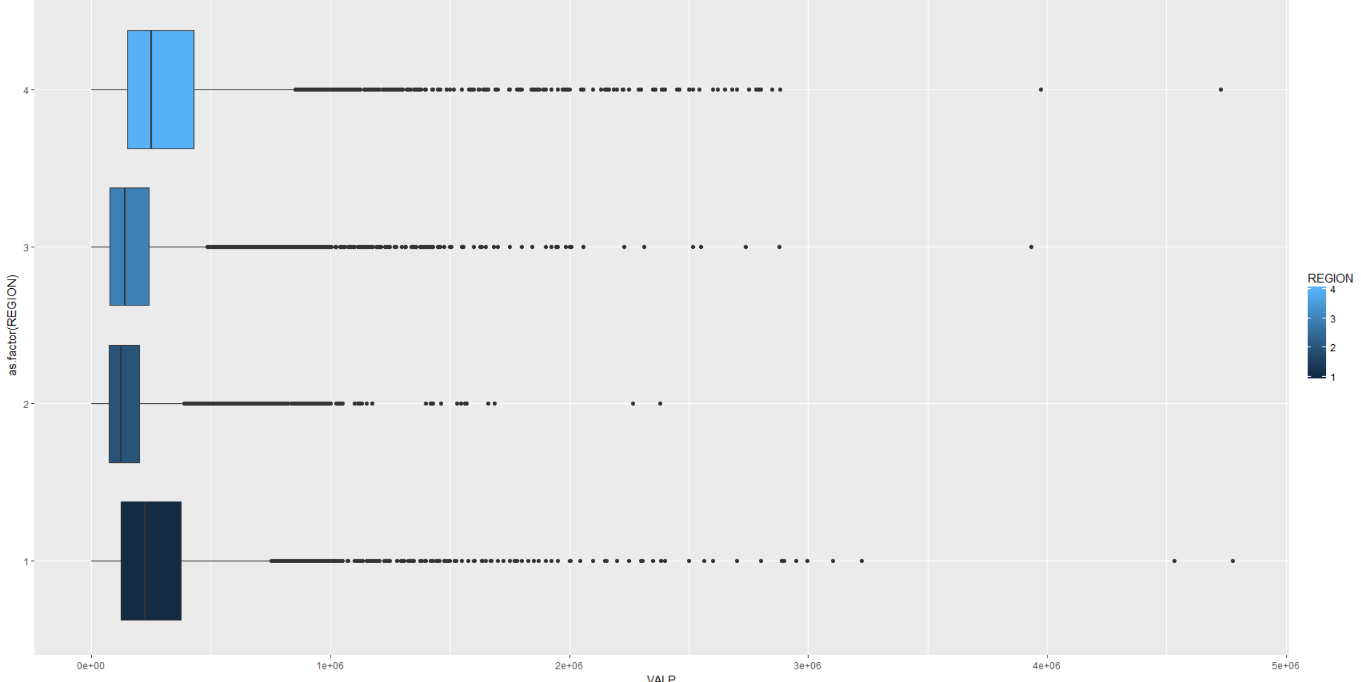
VALP vs Region…property value differing across regions

Slide 6
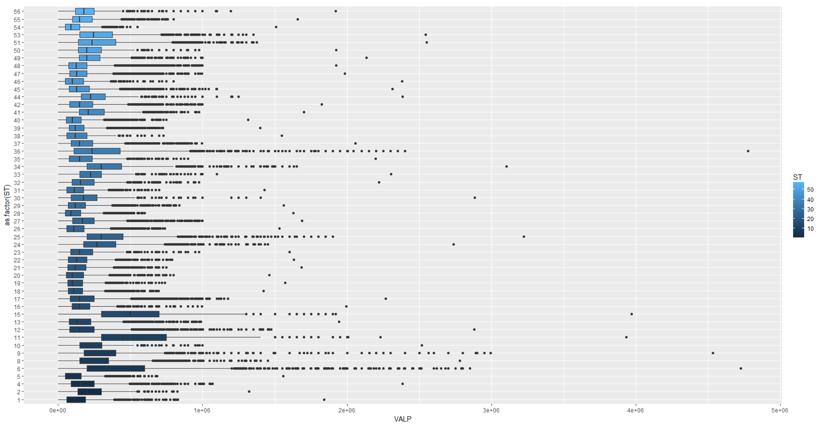
VALP vs ST…property value differing across different states

Slide 7
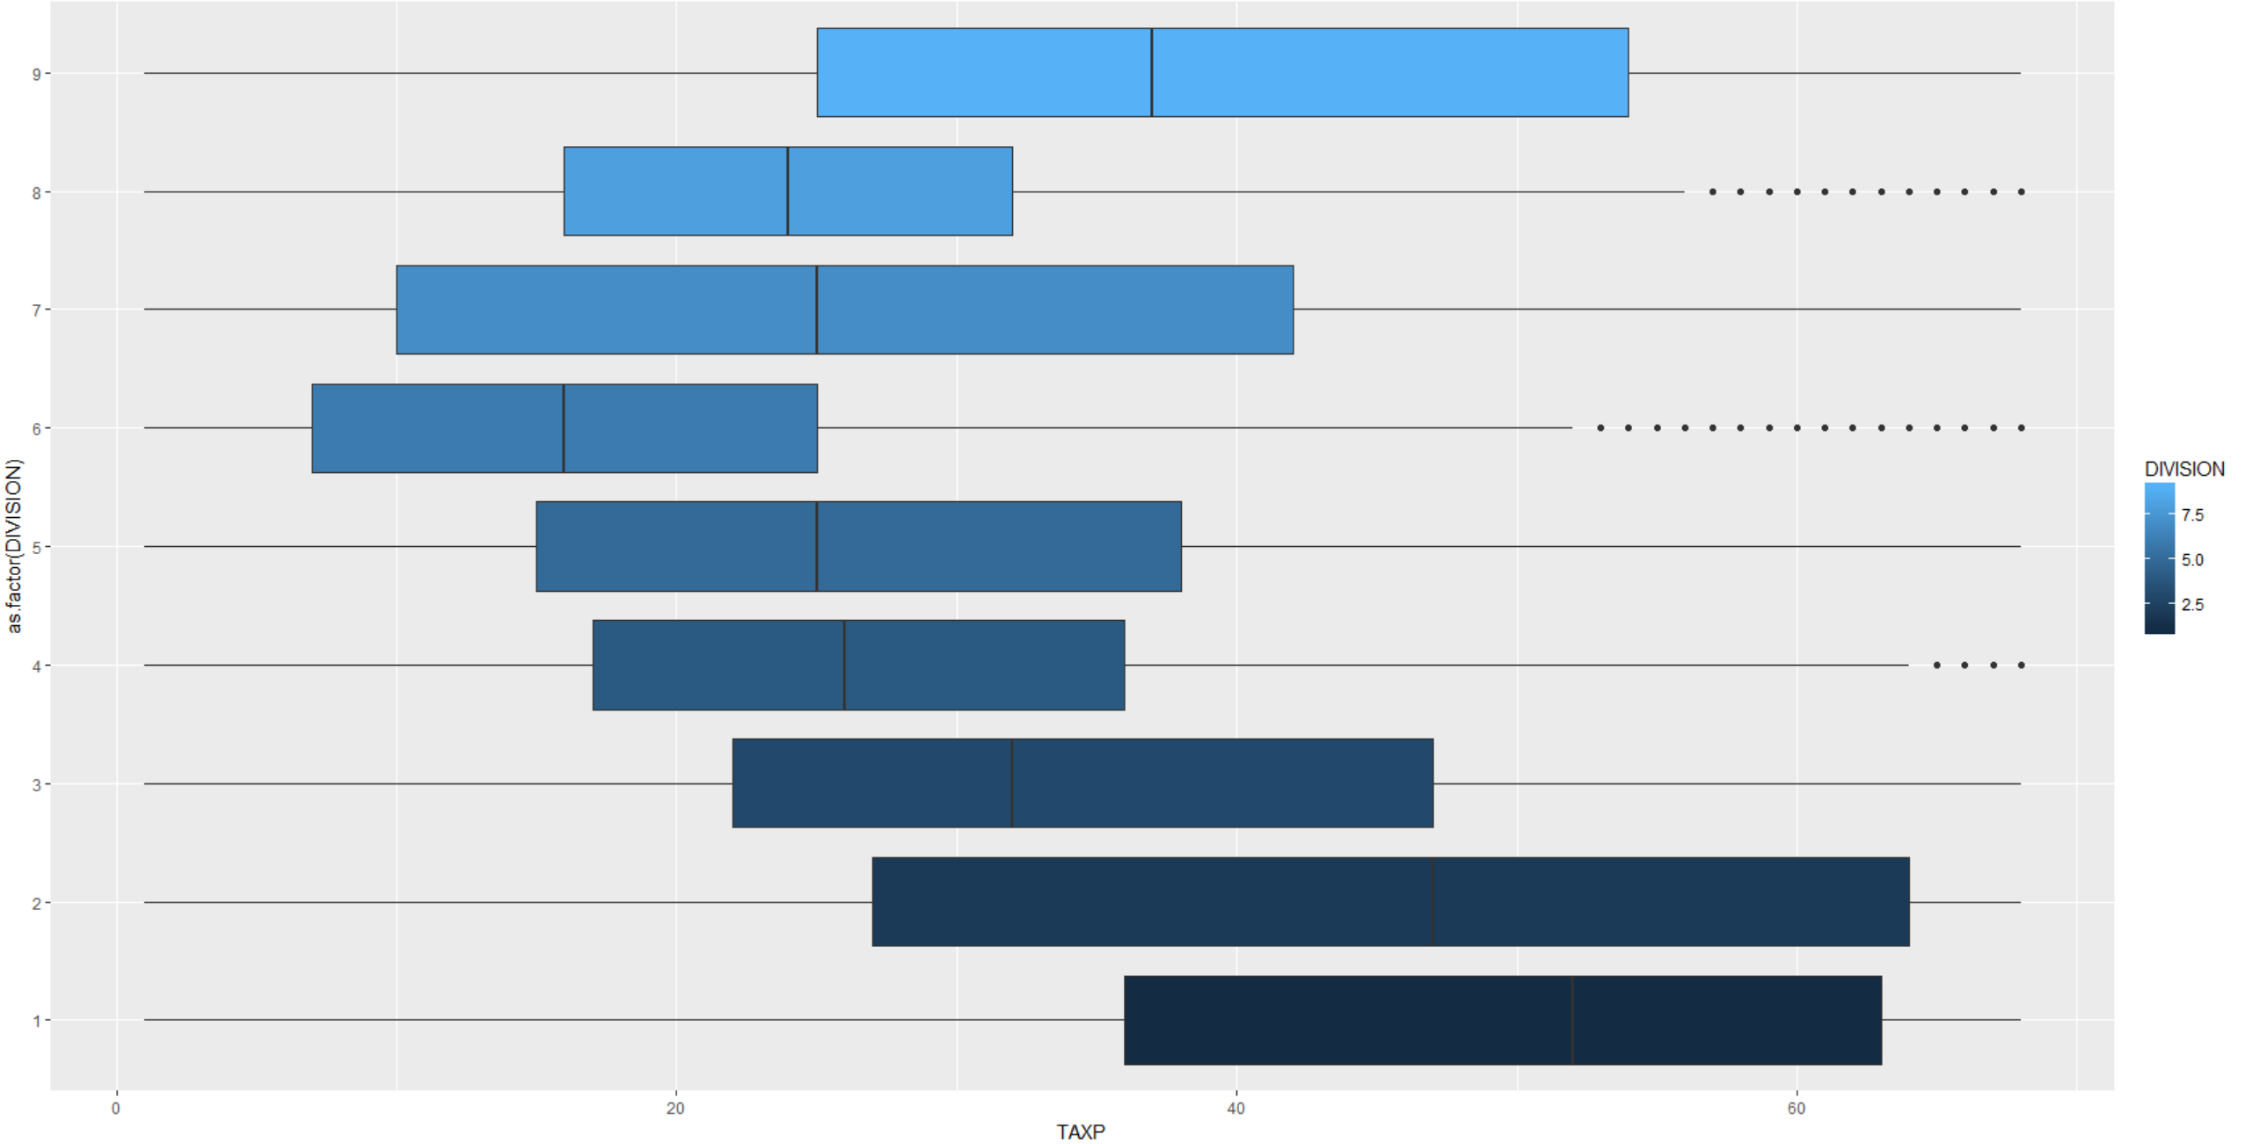
TAXP vs Division…Property tax differing across Divisions

Slide 8
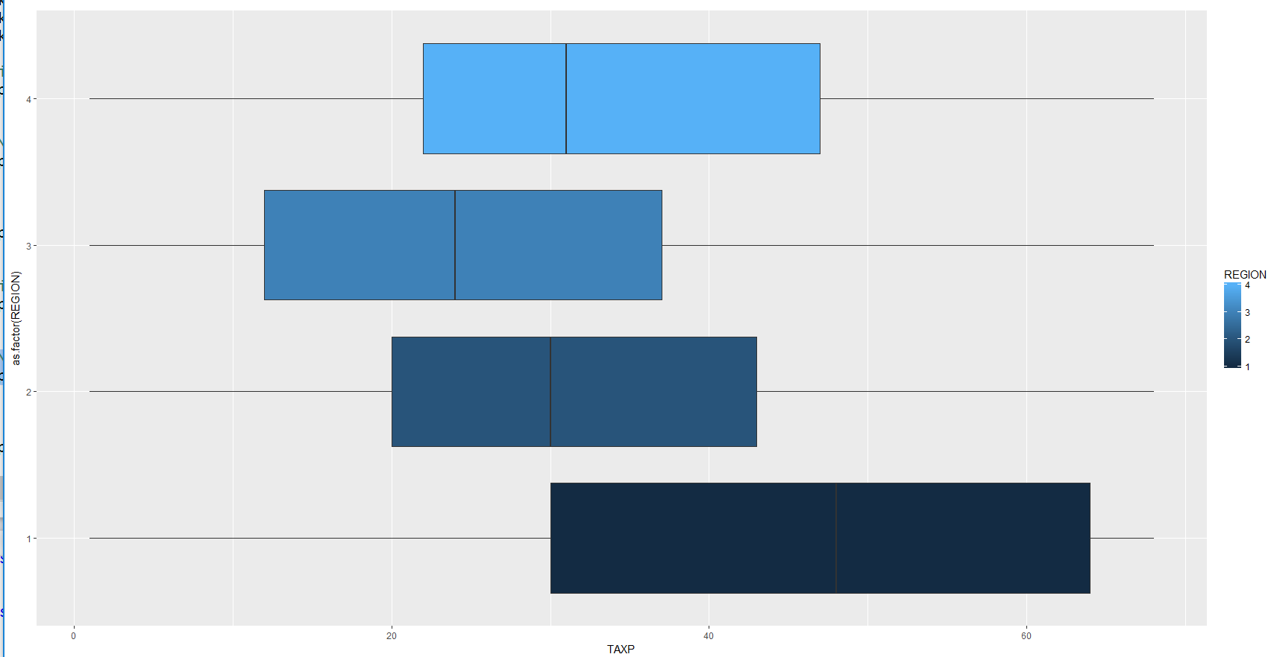
TAXP vs Region…property tax differing across regions

Slide 9
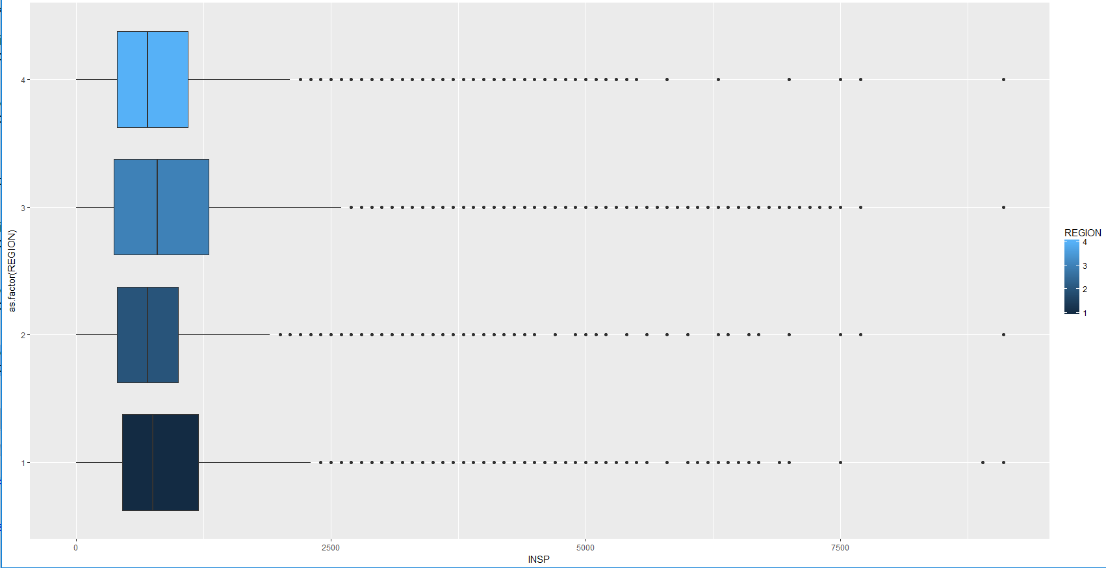
INSP vs Region…property insurance slightly differing across Regions

Slide 10
Correlation Analysis…
cor.test(imputedhousedatabkup$VALP, imputedhousedatabkup$TAXP) #0.4727348
cor.test(imputedhousedatabkup$VALP, imputedhousedatabkup$INSP) #0.4357165
cor.test(imputedhousedatabkup$VALP, imputedhousedatabkup$HINCP) #0.4202834
cor.test(imputedhousedatabkup$VALP, imputedhousedatabkup$FULP) #0.03702378
cor.test(imputedhousedatabkup$VALP, imputedhousedatabkup$ELEP) #0.1727555
Value of Property shows slight correlation with Property Tax, Property Insurance and Household Income

Slide 11
Anova Analysis
significant difference of VALP across ST
significant difference of TAXP across ST

Slide 12
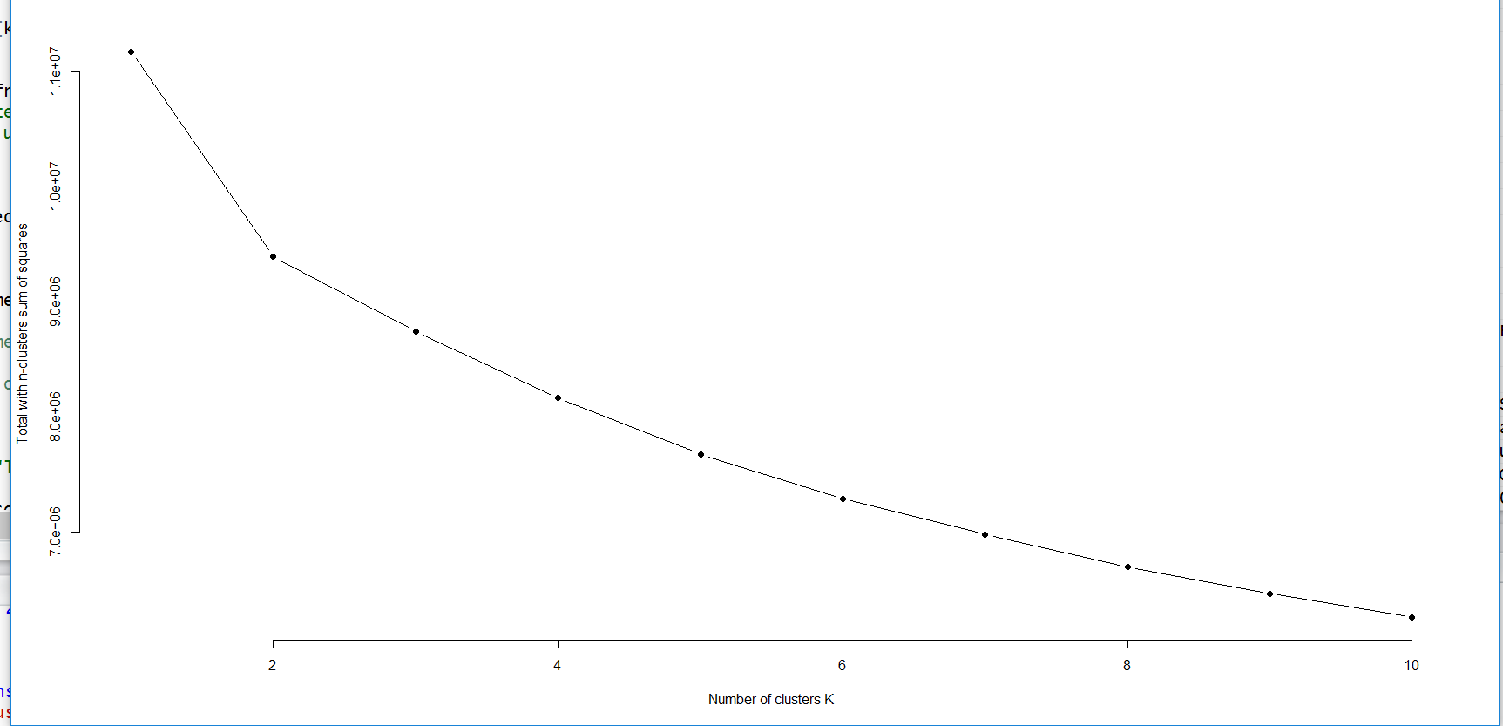
Clustering the entire dataset to see the homogenous group

Slide 13
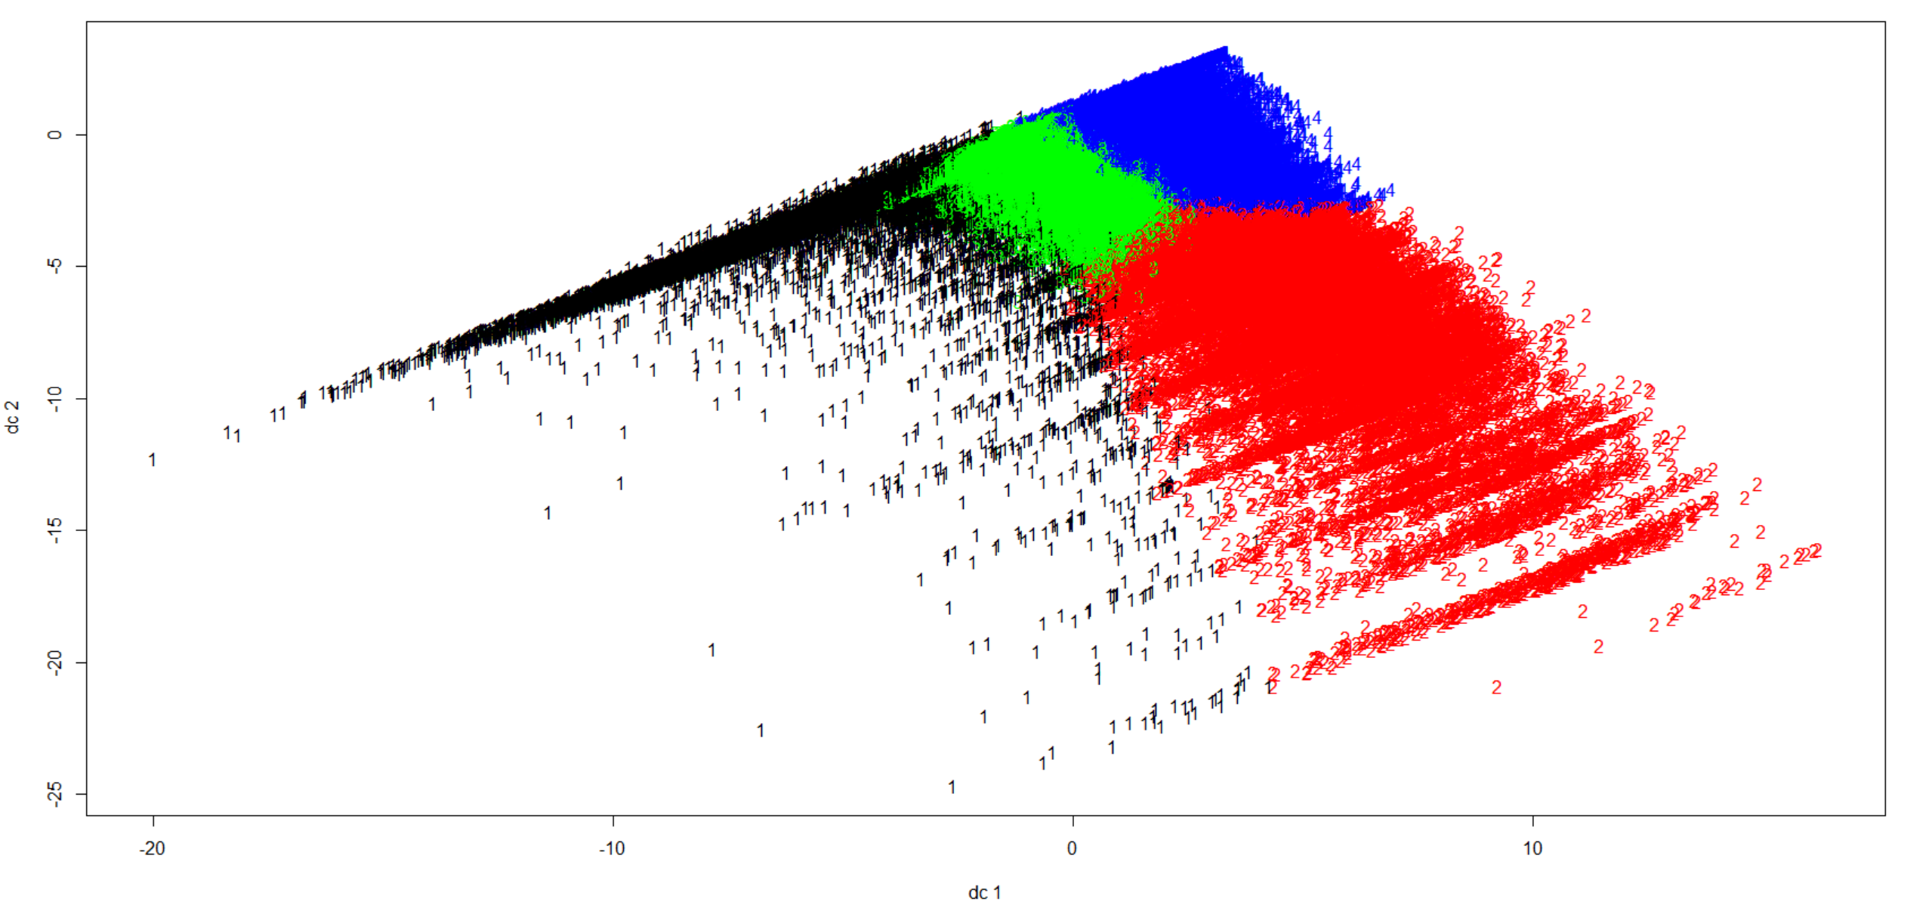
Four homogenous groups

Slide 14
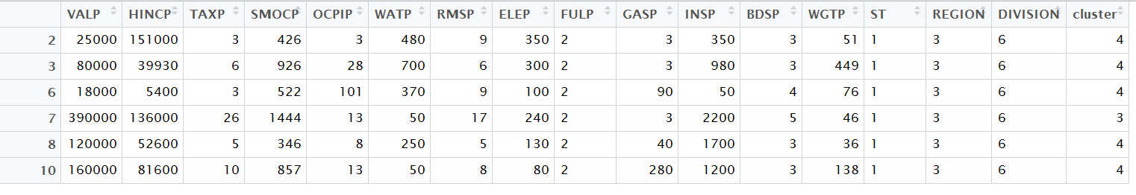
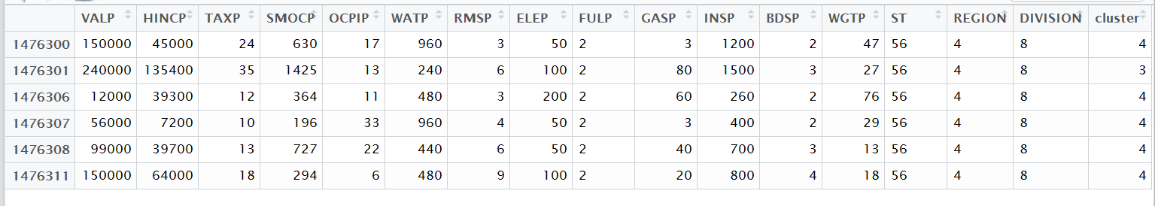
Cluster membership added to the entire group

Slide 15
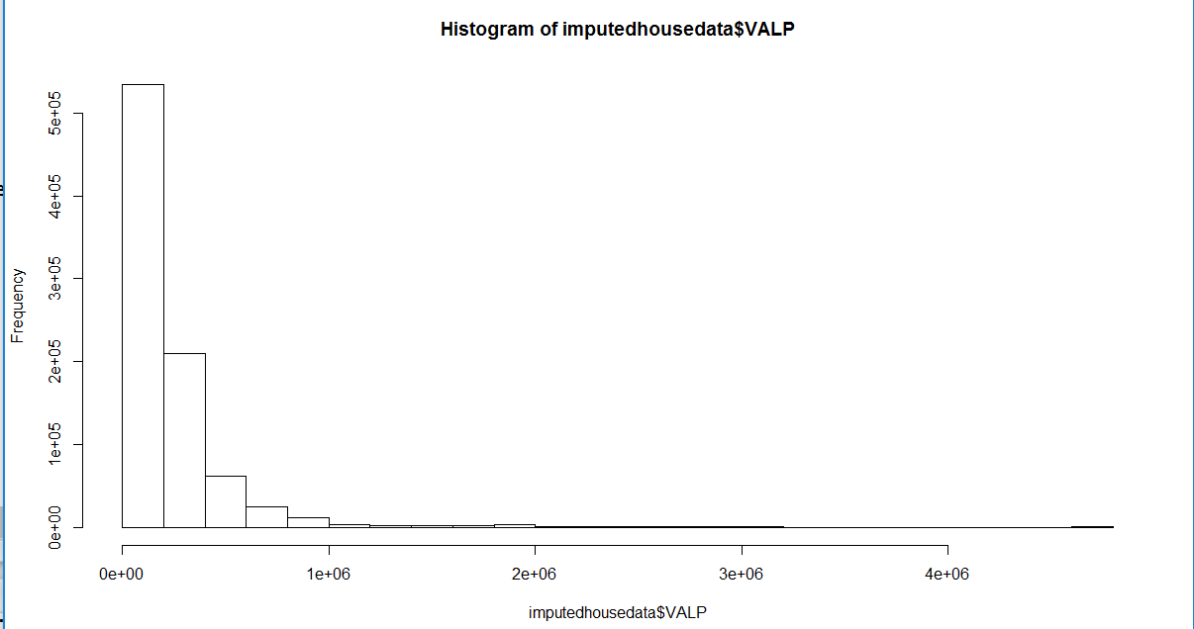
Response variable distribution

Slide 16
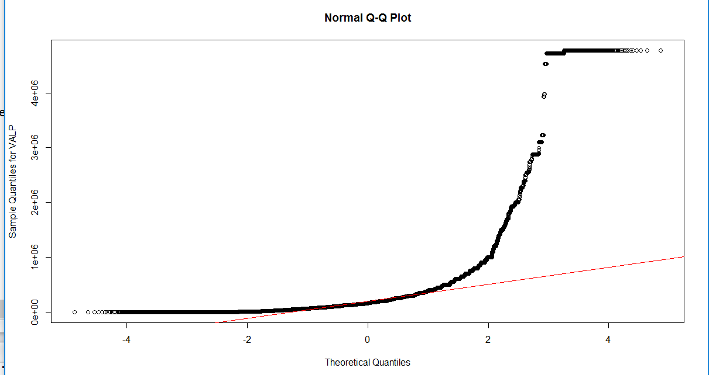
Response variable distribution…the QQ plot

Slide 17
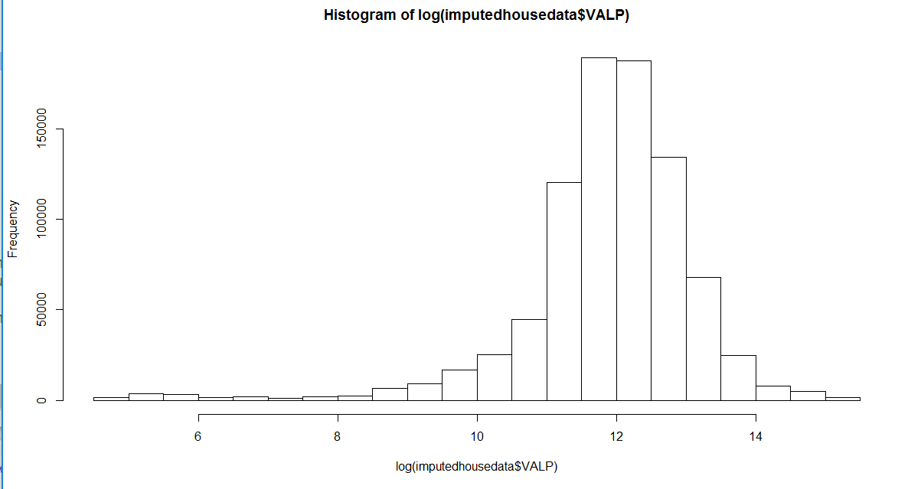
Response variable distribution with log transformation

Slide 18
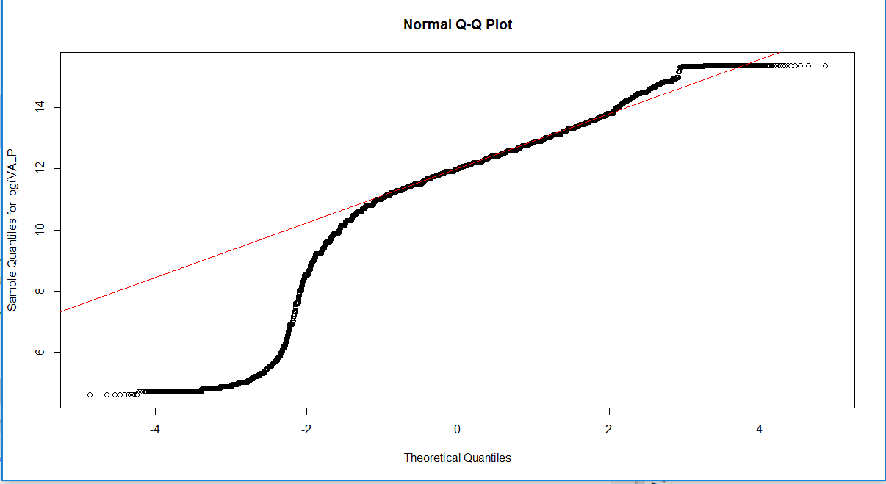
Response variable distribution with log transformation..QQ plot

Slide 19
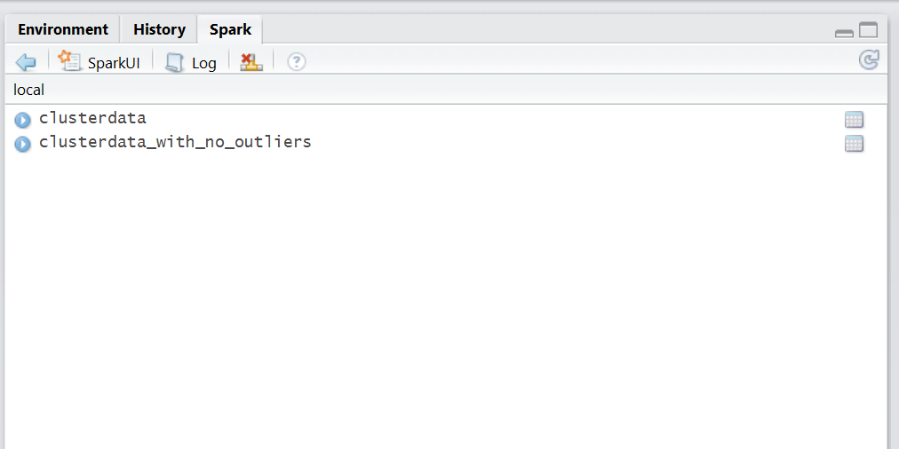
Data Loaded in Spark using Sparklyr

Slide 20
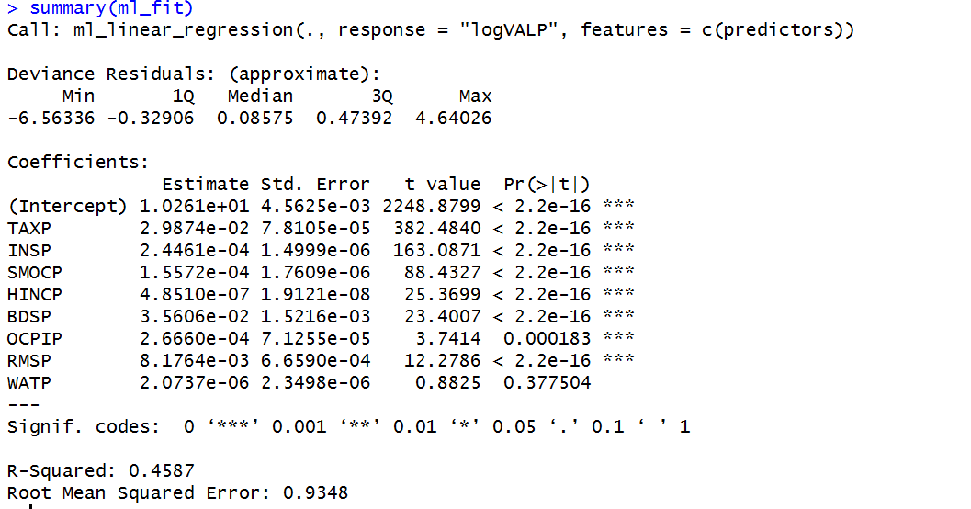
Linear Regression with log transformation

Slide 21
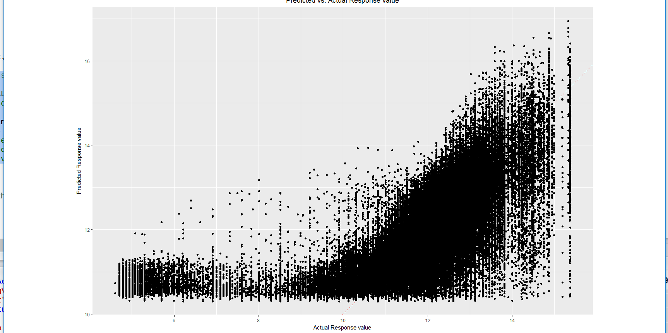
Linear Regression with log transformation.. Actual vs Predicted

Slide 22
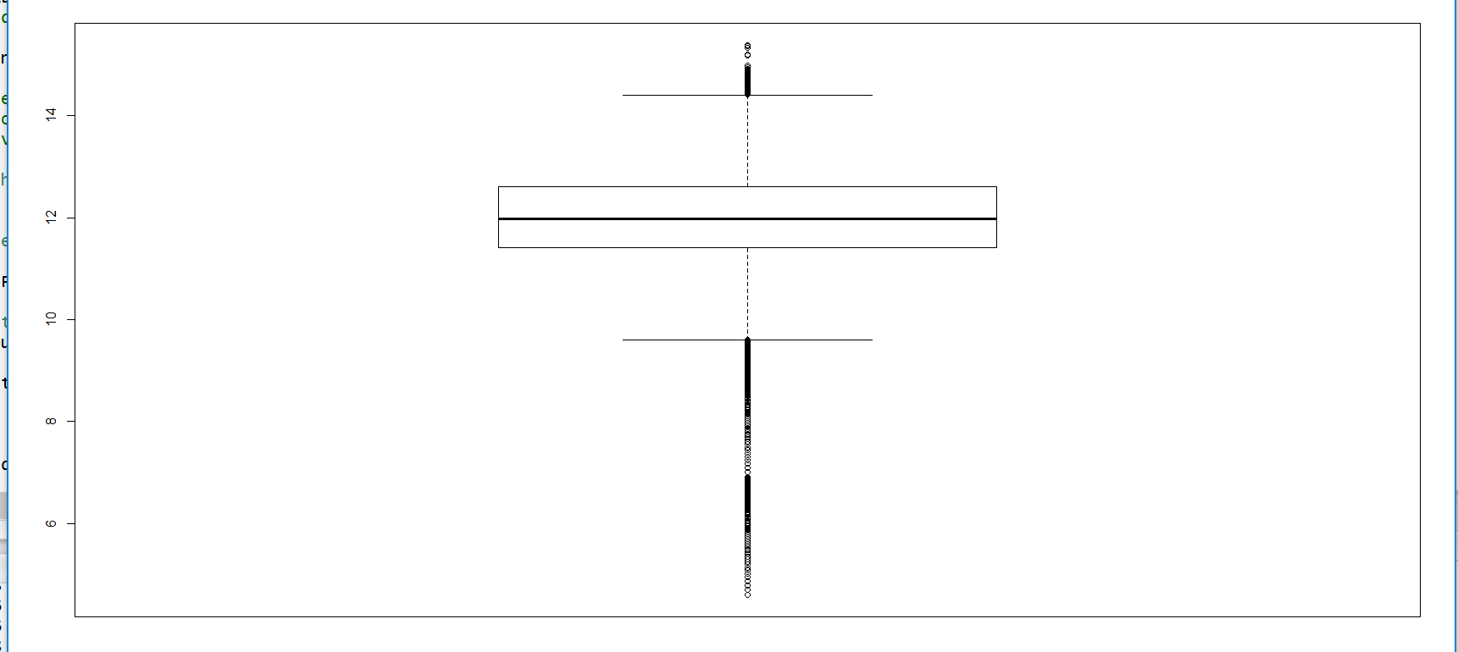
Response Variable and Outliers..Boxplot shows huge outliers

Slide 23
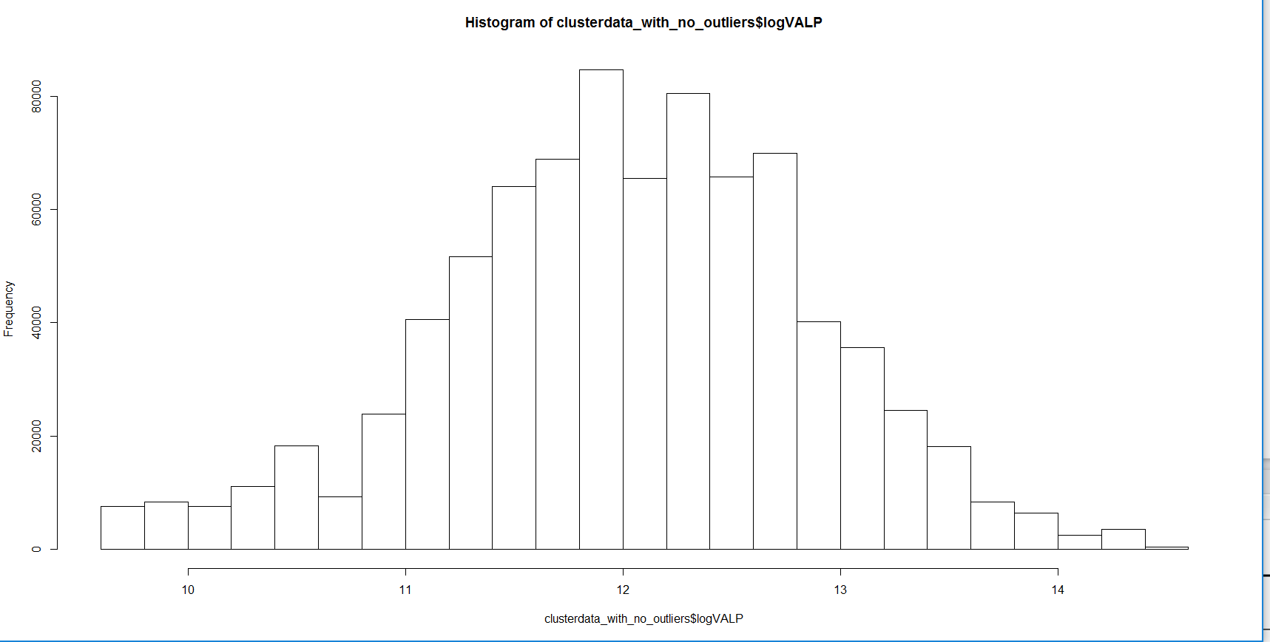
Response Variable after Outliers removal displays bell curve

Slide 24
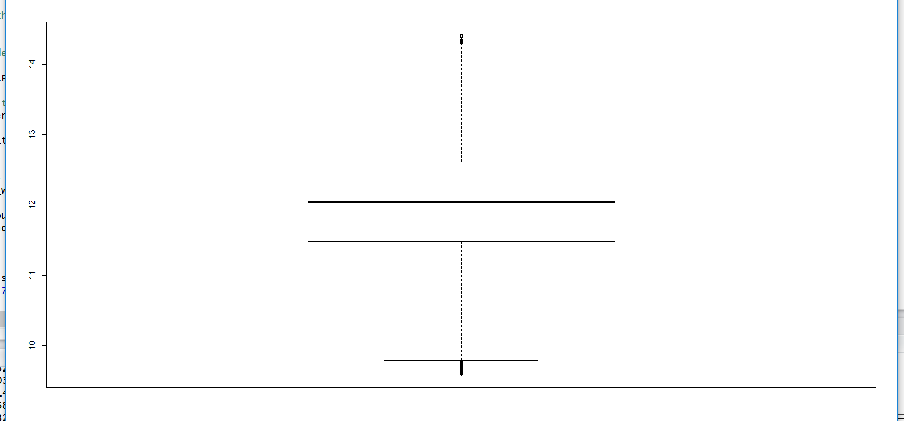
Response Variable after Outliers removal…boxplot shows no outliers

Slide 25
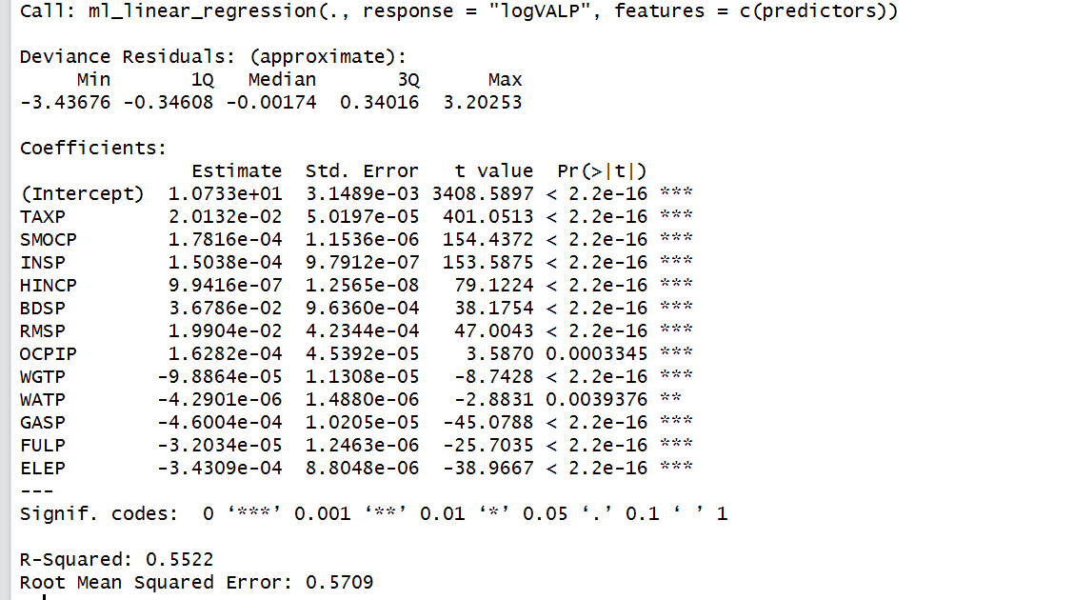
Linear Regression with outliers removal…RMSE reduced to a large extent

Slide 26
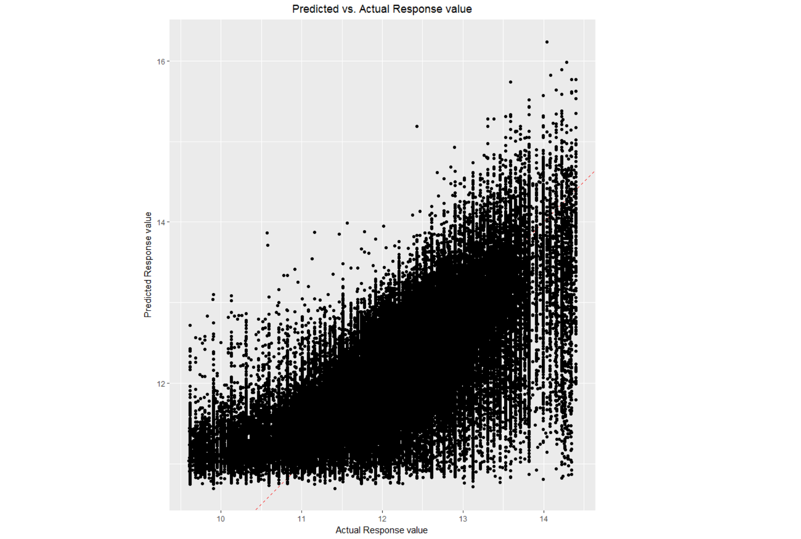
Linear Regression with outliers removal…Actual vs Predicted values

Slide 27
Conclusions…
With outliers treatment, we could reduce the RMSE from 0.93 to 0.57, still there is a lot of scope to tune the model to further reduce the RMSE so that the model can predict the property value more accurately.
From the above model, we can infer that an unit increase in TAXP will increase the VALP by 0.02
Unit increase in SMOCP, VALP will increase by 0.0001
Unit increase in INSP, VALP will increase by 0.0001
Unit increase in HINCP, VALP will increase by 0.0000099
Unit increase in BDSP, VALP will increase by 0.0367
Unit increase in RMSP, VALP will increase by 0.0199
Unit increase in OCPIP, VALP will increase by 0.00016
Unit increase in WGTP, VALP will decrease by 0.0000988

Slide 28
Conclusions…
Unit increase in WATP, VALP will decrease by 0.00000429
Unit increase in GASP, VALP will decrease by 0.00046
Unit increase in FULP, VALP will decrease by 0.000032
Unit increase in ELEP, VALP will decrease by 0.000343

